Slide 1
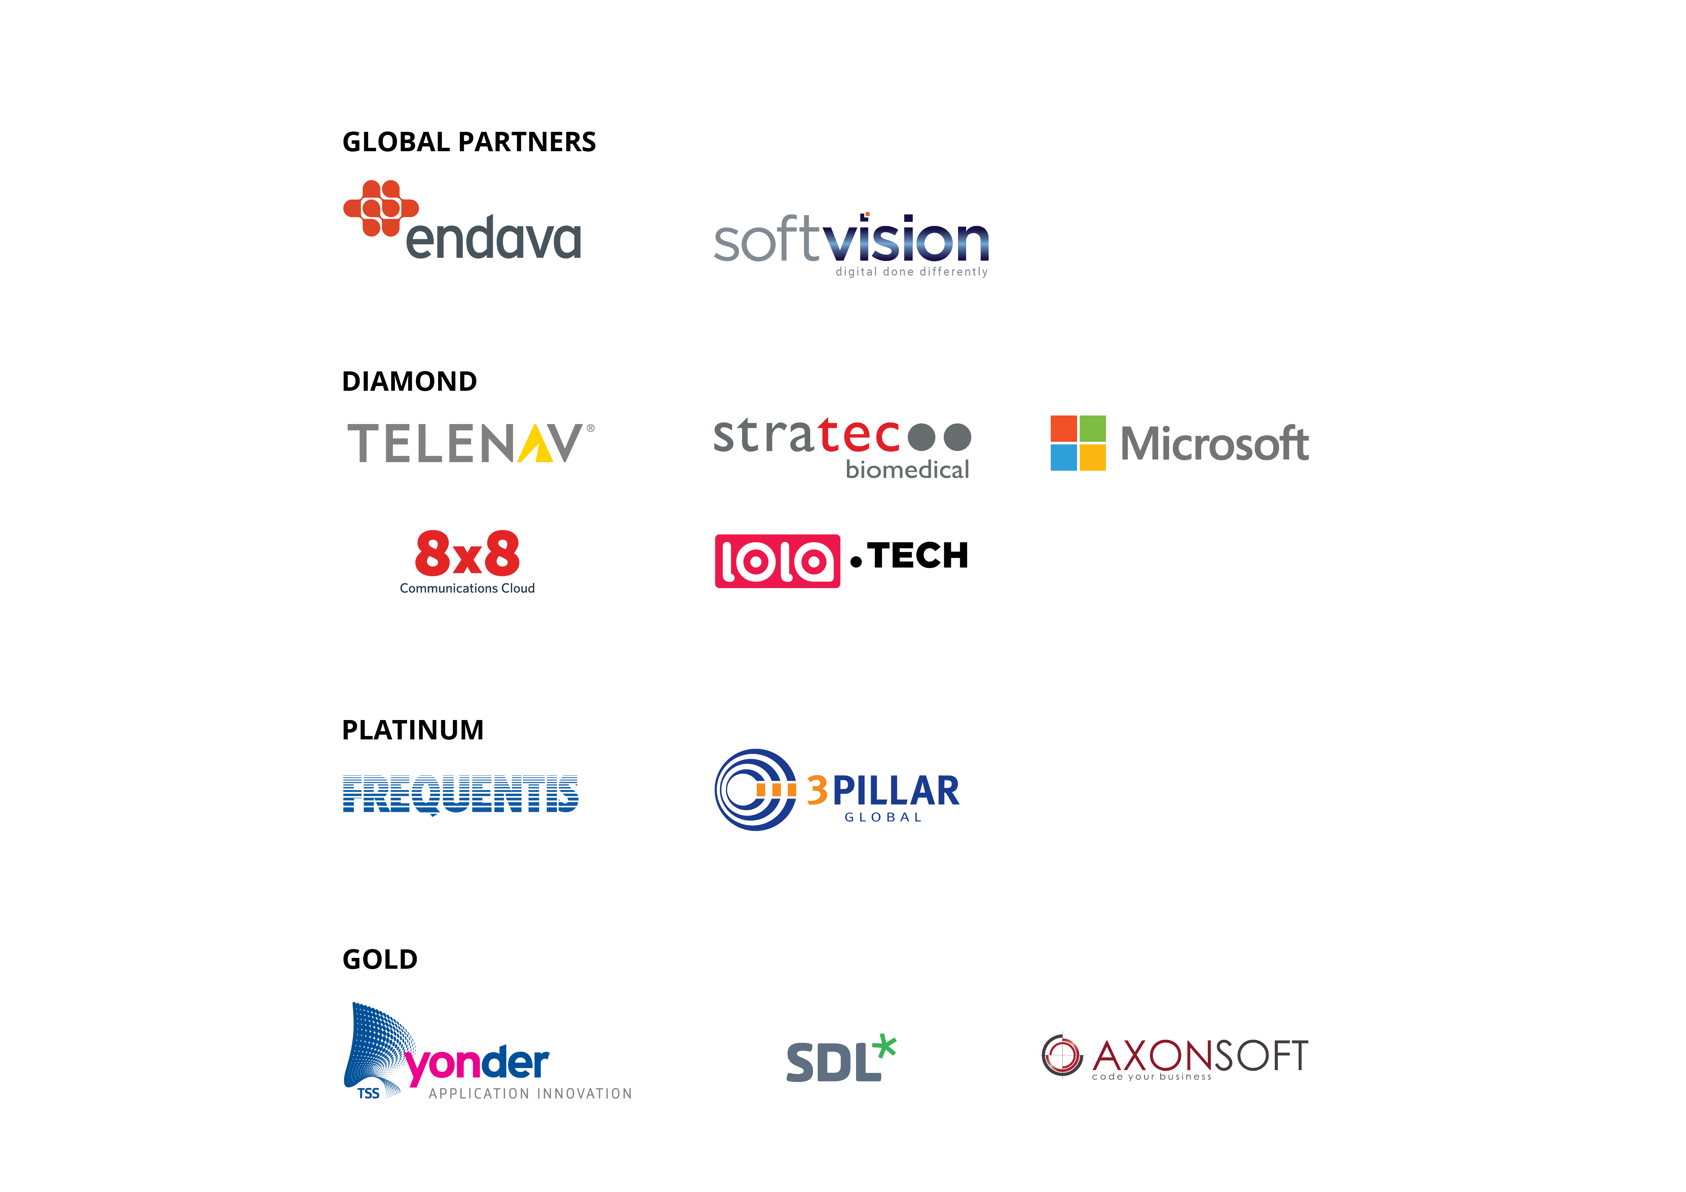

Slide 2




VR for the rest of us
@JobavaL10n

Slide 3


Slide 4
VR? What? Why?
EXPERIENCE
Notes:
We aren't talking about mere translation, but the cultural adaptation of software. This involves not just language, but also local customs and country. For example, Spanish is spoken in Latin America, but each country has a distinct dialect and even different styles of address and expression. For that reason, Firefox is localized not into Spanish, but Spain-Spanish, Argentinian, Chilean, Mexican etc.

Slide 5
VR? What? Why?
EXPERIENCE
IMMERSION
Notes:
We aren't talking about mere translation, but the cultural adaptation of software. This involves not just language, but also local customs and country. For example, Spanish is spoken in Latin America, but each country has a distinct dialect and even different styles of address and expression. For that reason, Firefox is localized not into Spanish, but Spain-Spanish, Argentinian, Chilean, Mexican etc.

Slide 6
VR? What? Why??
EXPERIENCE
IMMERSION
INTERACTION
Notes:
We aren't talking about mere translation, but the cultural adaptation of software. This involves not just language, but also local customs and country. For example, Spanish is spoken in Latin America, but each country has a distinct dialect and even different styles of address and expression. For that reason, Firefox is localized not into Spanish, but Spain-Spanish, Argentinian, Chilean, Mexican etc.

Slide 7
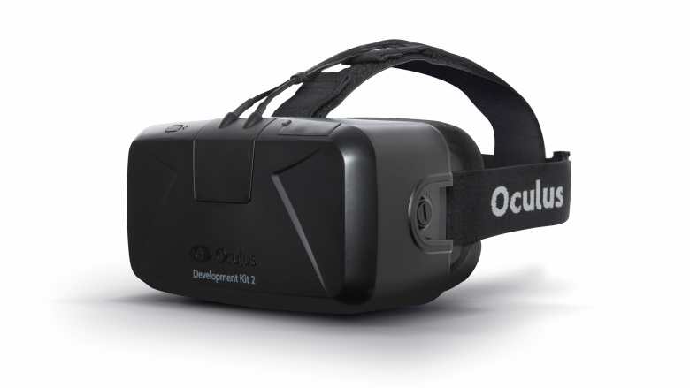
History
Notes:
We aren't talking about mere translation, but the cultural adaptation of software. This involves not just language, but also local customs and country. For example, Spanish is spoken in Latin America, but each country has a distinct dialect and even different styles of address and expression. For that reason, Firefox is localized not into Spanish, but Spain-Spanish, Argentinian, Chilean, Mexican etc.

Slide 8
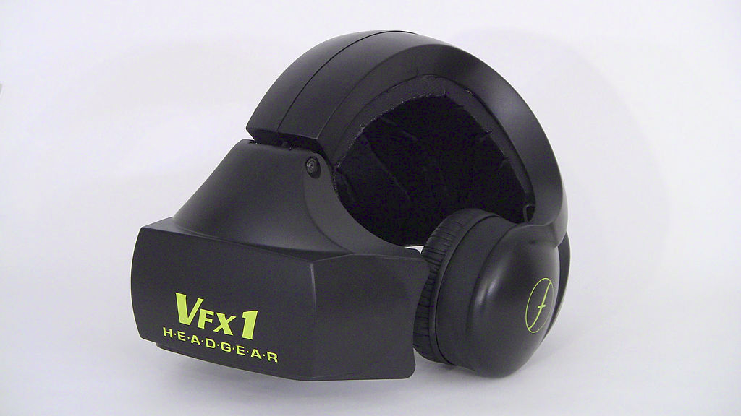
History
Notes:
We aren't talking about mere translation, but the cultural adaptation of software. This involves not just language, but also local customs and country. For example, Spanish is spoken in Latin America, but each country has a distinct dialect and even different styles of address and expression. For that reason, Firefox is localized not into Spanish, but Spain-Spanish, Argentinian, Chilean, Mexican etc.

Slide 9
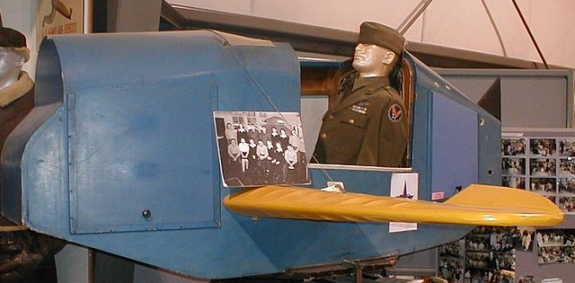
History
Notes:
We aren't talking about mere translation, but the cultural adaptation of software. This involves not just language, but also local customs and country. For example, Spanish is spoken in Latin America, but each country has a distinct dialect and even different styles of address and expression. For that reason, Firefox is localized not into Spanish, but Spain-Spanish, Argentinian, Chilean, Mexican etc.

Slide 10

History
Notes:
We aren't talking about mere translation, but the cultural adaptation of software. This involves not just language, but also local customs and country. For example, Spanish is spoken in Latin America, but each country has a distinct dialect and even different styles of address and expression. For that reason, Firefox is localized not into Spanish, but Spain-Spanish, Argentinian, Chilean, Mexican etc.

Slide 11
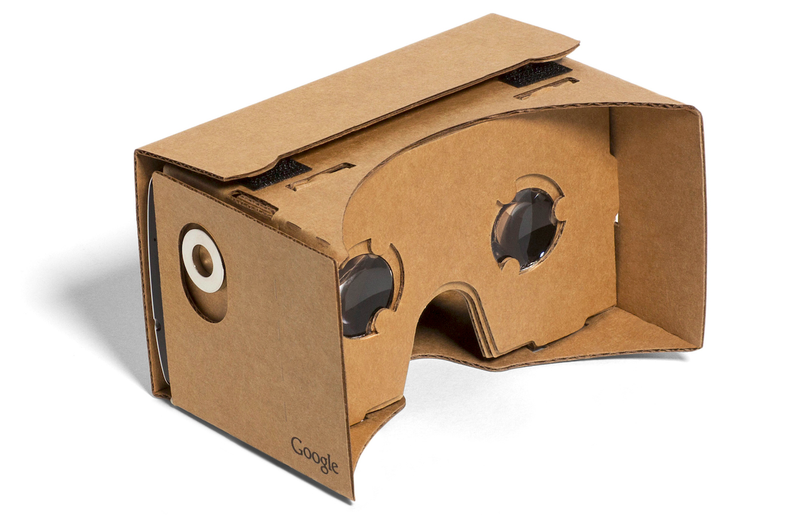
History
Notes:
We aren't talking about mere translation, but the cultural adaptation of software. This involves not just language, but also local customs and country. For example, Spanish is spoken in Latin America, but each country has a distinct dialect and even different styles of address and expression. For that reason, Firefox is localized not into Spanish, but Spain-Spanish, Argentinian, Chilean, Mexican etc.

Slide 12
360
Demo time
Notes:
We aren't talking about mere translation, but the cultural adaptation of software. This involves not just language, but also local customs and country. For example, Spanish is spoken in Latin America, but each country has a distinct dialect and even different styles of address and expression. For that reason, Firefox is localized not into Spanish, but Spain-Spanish, Argentinian, Chilean, Mexican etc.

Slide 13


Stereo
Notes:
We aren't talking about mere translation, but the cultural adaptation of software. This involves not just language, but also local customs and country. For example, Spanish is spoken in Latin America, but each country has a distinct dialect and even different styles of address and expression. For that reason, Firefox is localized not into Spanish, but Spain-Spanish, Argentinian, Chilean, Mexican etc.

Slide 14
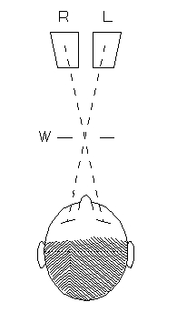
Stereo
Notes:
We aren't talking about mere translation, but the cultural adaptation of software. This involves not just language, but also local customs and country. For example, Spanish is spoken in Latin America, but each country has a distinct dialect and even different styles of address and expression. For that reason, Firefox is localized not into Spanish, but Spain-Spanish, Argentinian, Chilean, Mexican etc.

Slide 15
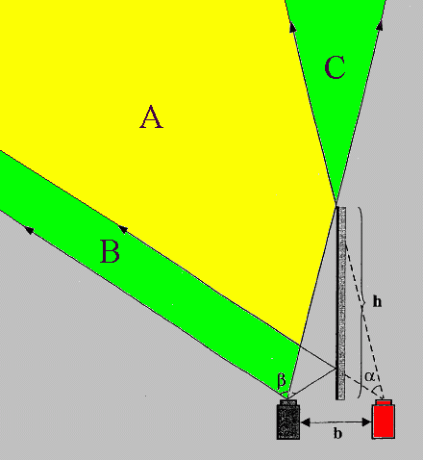
Stereo
Notes:
We aren't talking about mere translation, but the cultural adaptation of software. This involves not just language, but also local customs and country. For example, Spanish is spoken in Latin America, but each country has a distinct dialect and even different styles of address and expression. For that reason, Firefox is localized not into Spanish, but Spain-Spanish, Argentinian, Chilean, Mexican etc.

Slide 16
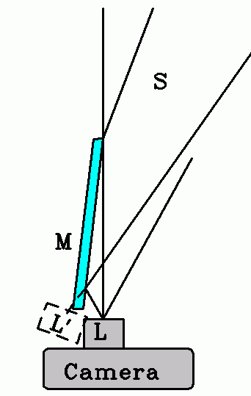
Stereo
Notes:
We aren't talking about mere translation, but the cultural adaptation of software. This involves not just language, but also local customs and country. For example, Spanish is spoken in Latin America, but each country has a distinct dialect and even different styles of address and expression. For that reason, Firefox is localized not into Spanish, but Spain-Spanish, Argentinian, Chilean, Mexican etc.

Slide 17
Stereo
Demo time
Notes:
We aren't talking about mere translation, but the cultural adaptation of software. This involves not just language, but also local customs and country. For example, Spanish is spoken in Latin America, but each country has a distinct dialect and even different styles of address and expression. For that reason, Firefox is localized not into Spanish, but Spain-Spanish, Argentinian, Chilean, Mexican etc.

Slide 18
Conclusions
Not daunting (hint: a-frame)
Can be tricky (implementation details)
Cheap
Fun

Slide 19

Questions?
Twitter: @JobavaL10n
Blog: medium.com/@Jobava/latest
Email: jobava@mozilla.ro

